Slide 1

Advanced CSS
Week 3

Slide 2
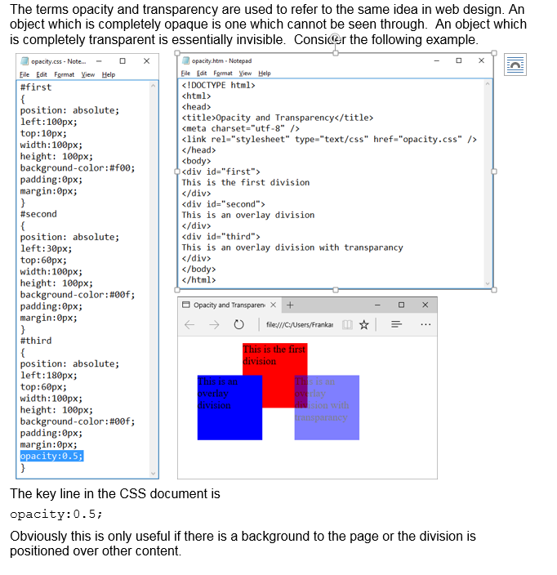
Opacity

Slide 3
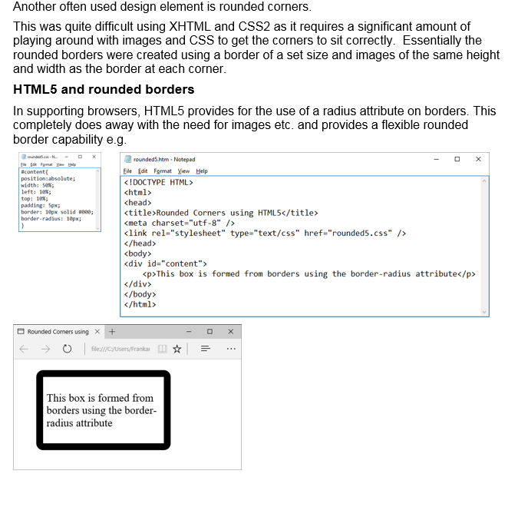
Rounded Corners

Slide 4
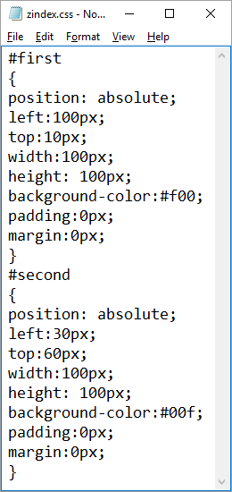
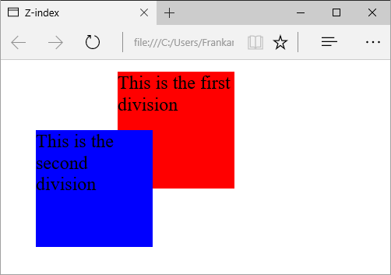
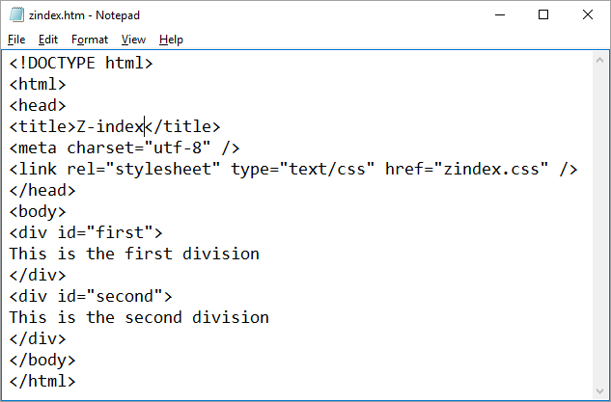
Z-index
When a XHTML page is rendered in a browser the objects are written to the page in the order in which they occur in the code. E.g. consider the following code and result
The first division is rendered and then the second is render over the top.
If we want to reverse the rendering so the second goes under the first, we could change the order in the HTML code however it can be better defined in CSS by using a z-index. Consider the following CSS which is attached to the same HTML document and the result.

Slide 5
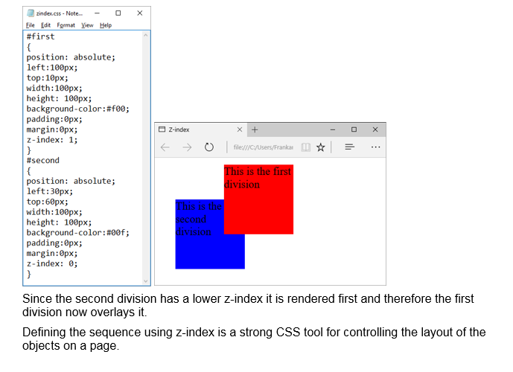

Slide 6
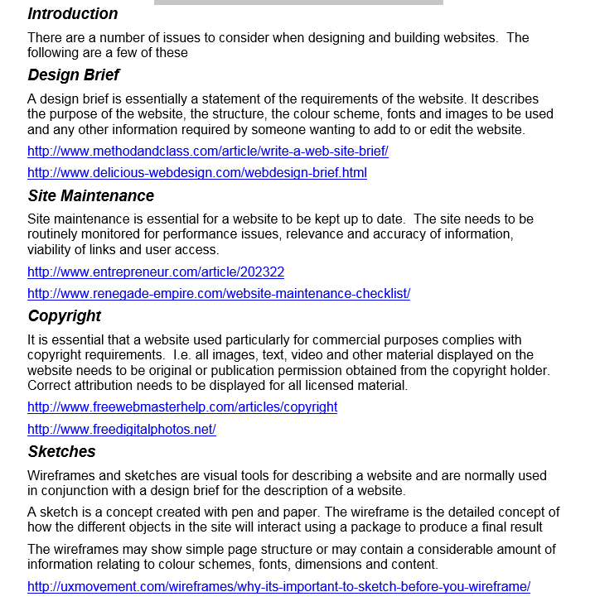
Designing and Building Websites

